Slide 1
Analysis of Student Learning Behavior
and Academic Performance
-Mohammed Aiman Sadhik
57112524

Slide 2
Project Overview
Objective
Data collection and understanding.
2. Cleaning and duplicate removal.
3.EDA and visualisation.
4. Correlation and statistical testing.
5.Multiple linear regression.
6. Power BI dashboard and reporting.
Analyse how learning habits, engagement, resources, motivation, stress, and other behavioral factors are associated with academic performance.
Dataset
Kaggle Student Performance and Learning Behavior Dataset: 14,003 records, 16 attributes.
Outcome
Primary outcome: ExamScore. FinalGrade is treated as a derived outcome and excluded from the regression predictors.
2

Slide 3
Problem Statement & Research Questions
Problem Statement
Educational institutions collect large amounts of student-related data, but identifying which learning and behavioral factors are associated with academic performance can be challenging. This project investigates relationships between study hours, attendance, assignment completion, motivation, stress, and academic performance.
Research Questions
1. How does study time relate to academic performance?
2. What relationship exists between attendance and exam scores?
3. Does assignment completion show an association with performance?
4. How are motivation and stress associated with performance?
5. Which learning and behavioral factors show the strongest relationship?
3

Slide 4
Dataset & Data Quality
14,003
Cleaning decision
Original records
Exact duplicate rows were removed. FinalGrade is strongly tied to ExamScore, so it is treated as a derived outcome rather than an independent regression predictor.
1,534
Exact duplicates
Key variables
12,469
Cleaned records
StudyHours, Attendance, Motivation, LearningStyle, OnlineCourses, Discussions, AssignmentCompletion, ExamScore, EduTech, StressLevel and FinalGrade.
0
Missing values
4

Slide 5
Methodology & Workflow
Data Understanding
EDA
Statistical Analysis
Visualization
Data Collection
Data Cleaning
Correlation
Regression
Findings & Conclusion
Statistical methods
Predictive model
Tools
Pearson correlation, one-way ANOVA, Tukey HSD post-hoc test.
Multiple linear regression with an 80/20 train-test split and random_state=42.
Python, Pandas, NumPy, Matplotlib, Seaborn, SciPy, Statsmodels, Scikit-learn, Power BI, GitHub.
5

Slide 6
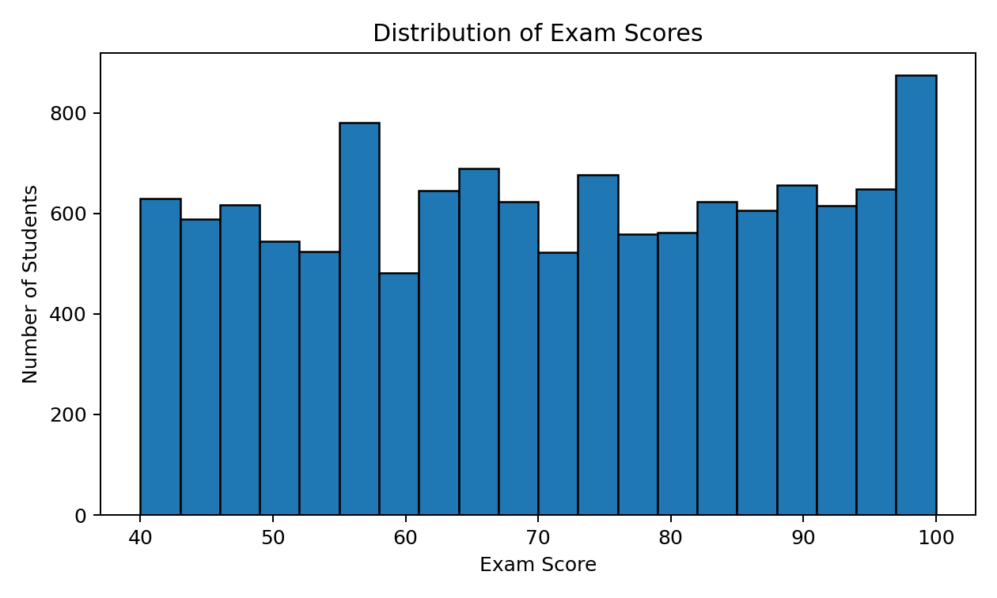
Data Cleaning & Preparation
• Loaded the Kaggle CSV into a Pandas DataFrame.
• Inspected structure, data types, ranges and descriptive statistics.
• Checked every column for missing values: none were found.
• Detected 1,534 exact duplicate records.
• Removed duplicates using drop_duplicates().
• Saved the cleaned dataset as student_performance_cleaned.csv.
• Final analysis dataset: 12,469 × 16.
6

Slide 7
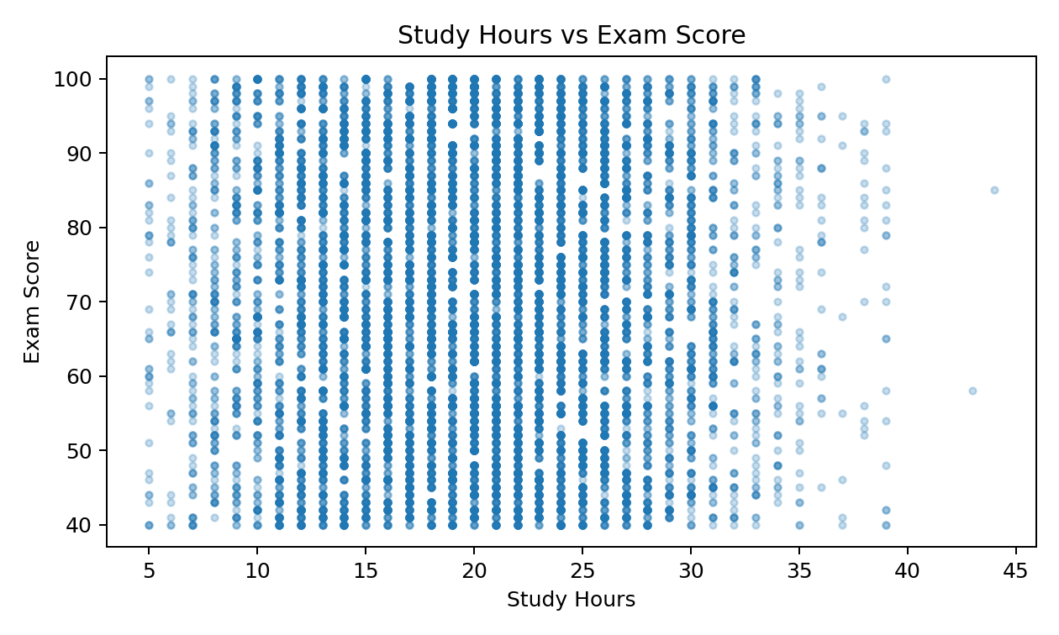
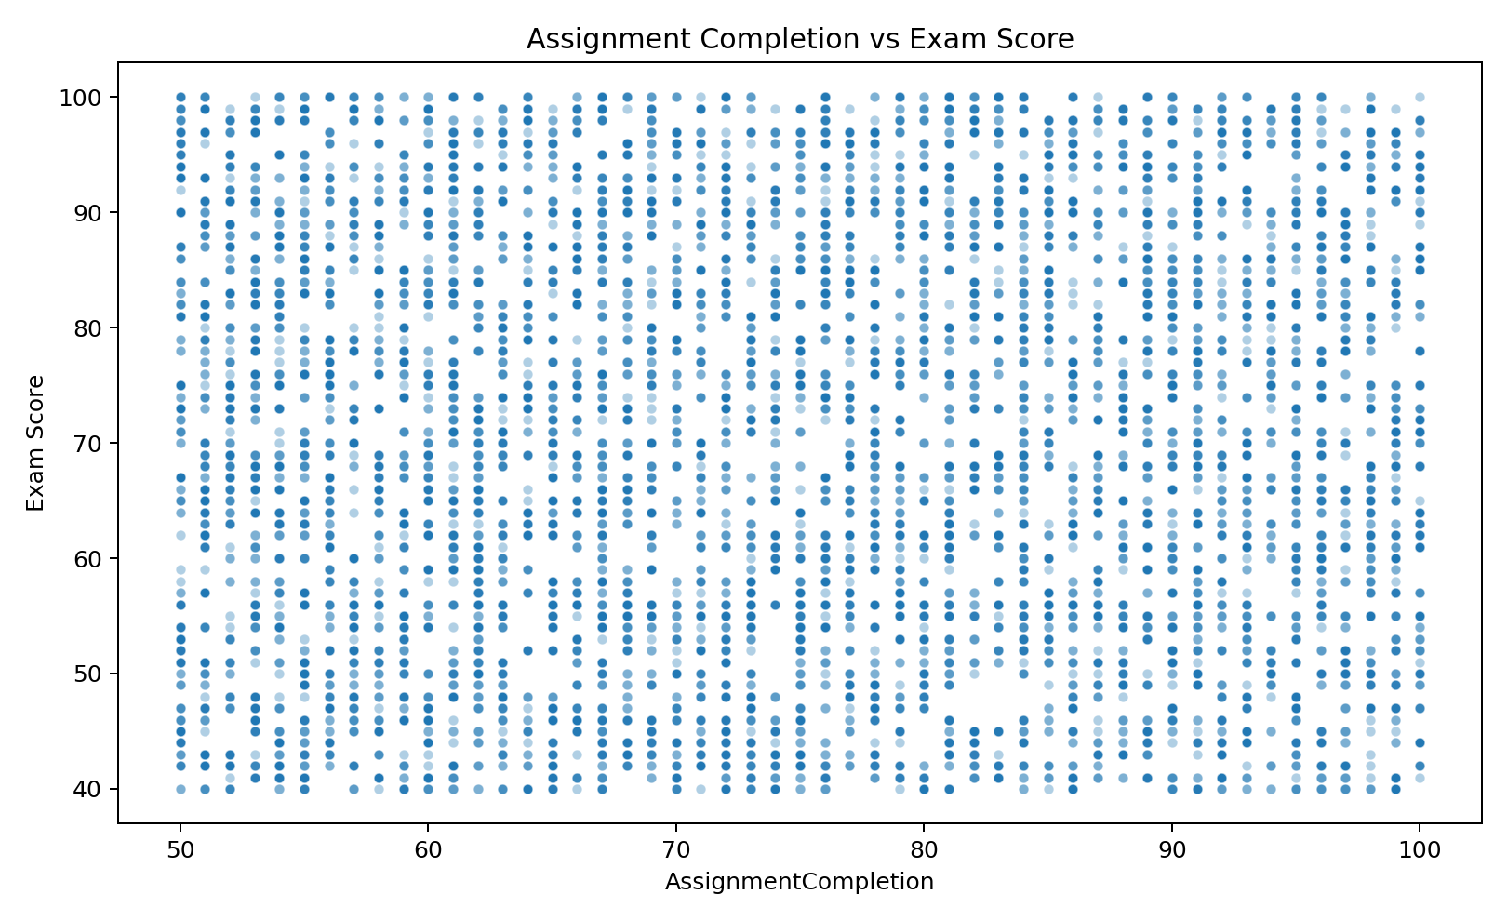
Exploratory Data Analysis
Average ExamScore: 70.31
StudyHours mean: 20.03
Attendance mean: 80.24
AssignmentCompletion mean: 74.52
• Visual inspection suggests weak linear relationships for several variables.
7

Slide 8
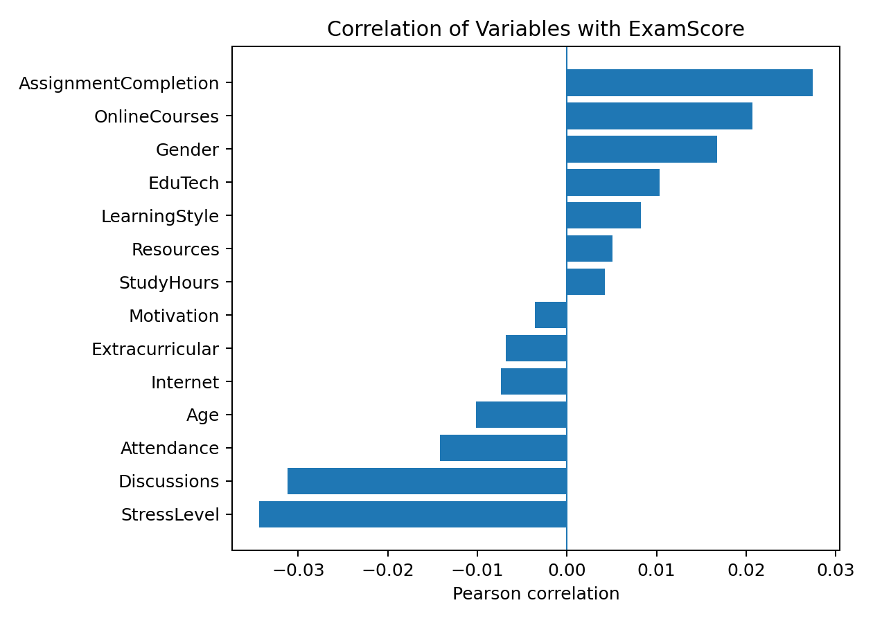
Correlation Analysis
Selected results
StressLevel: r = −0.0343, p < 0.001
Discussions: r = −0.0312, p = 0.0005
AssignmentCompletion: r = +0.0274, p = 0.0022
OnlineCourses: r = +0.0207, p = 0.0209
StudyHours: r = +0.0042, p = 0.6390
Attendance: r = −0.0142, p = 0.1140
8

Slide 9
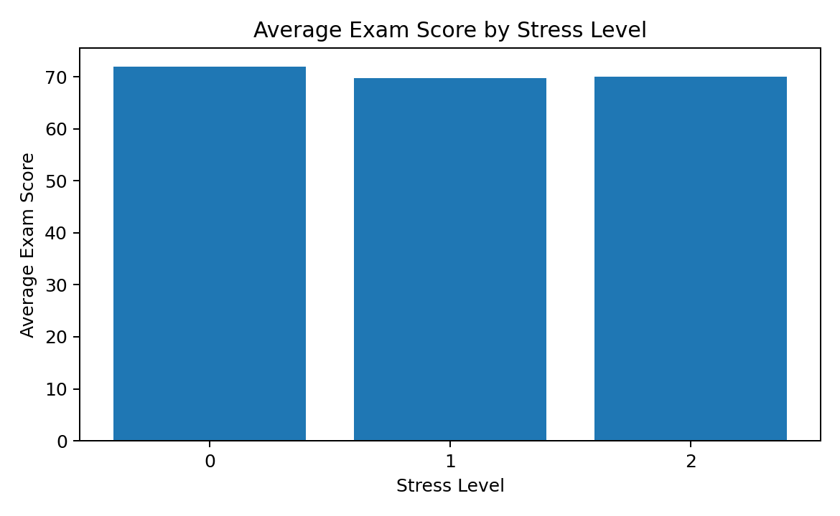
Statistical Analysis
Stress Level — ANOVA
Tukey HSD — Stress Level
Motivation ANOVA
F = 12.984, p < 0.001. The group means differ statistically, but the effect size is very small (η² ≈ 0.0021).
Level 0 vs 1: significant
Level 0 vs 2: significant
Level 1 vs 2: not significant
F = 0.906, p = 0.404 → no significant group difference.
9

Slide 10
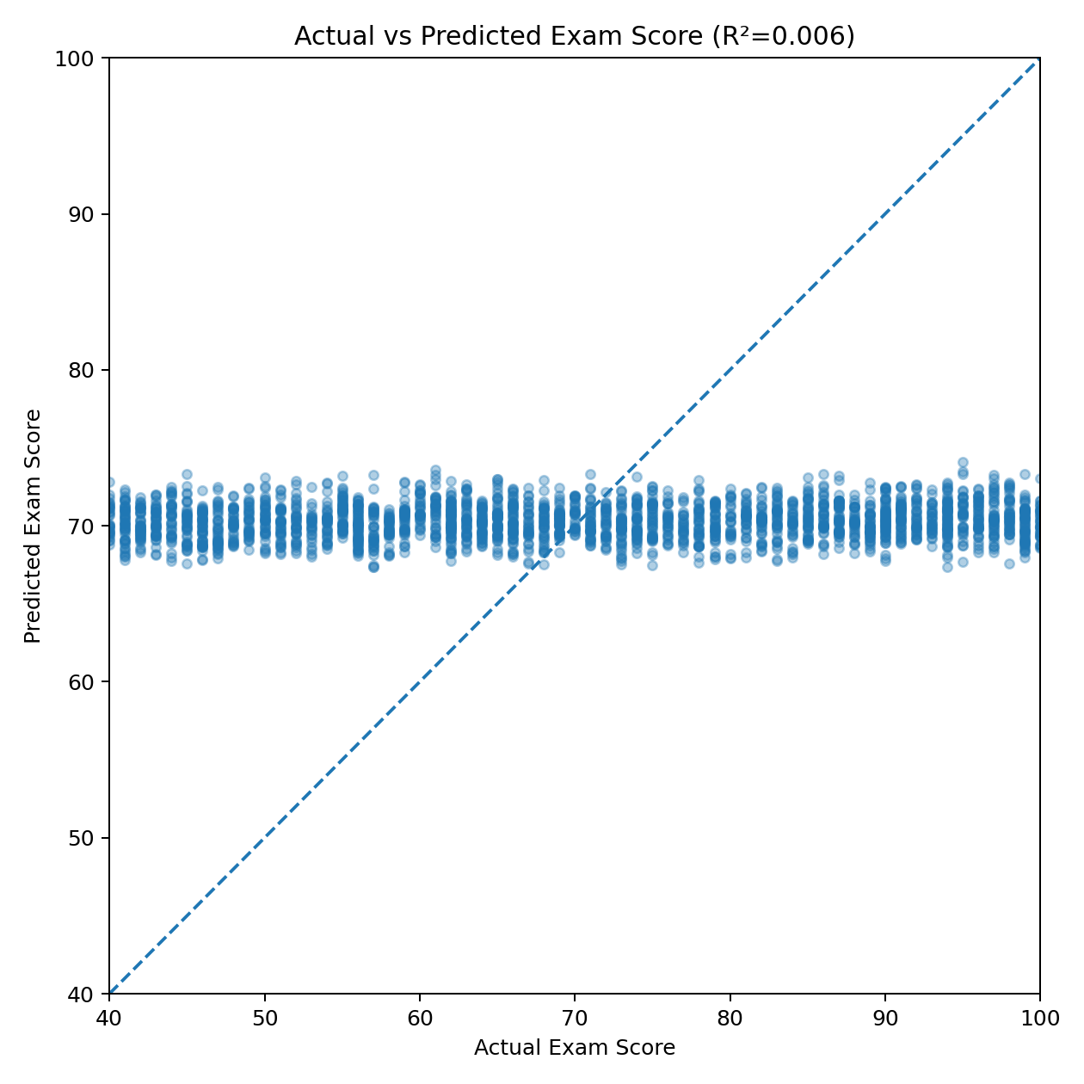
Multiple Linear Regression
0.0060
17.69
R²
RMSE
Interpretation
The model explains approximately 0.6% of the variation in ExamScore. The available behavioral variables therefore have weak overall predictive/explanatory power in this dataset.
Model setup
14 predictors; FinalGrade excluded to avoid outcome leakage.
10

Slide 11
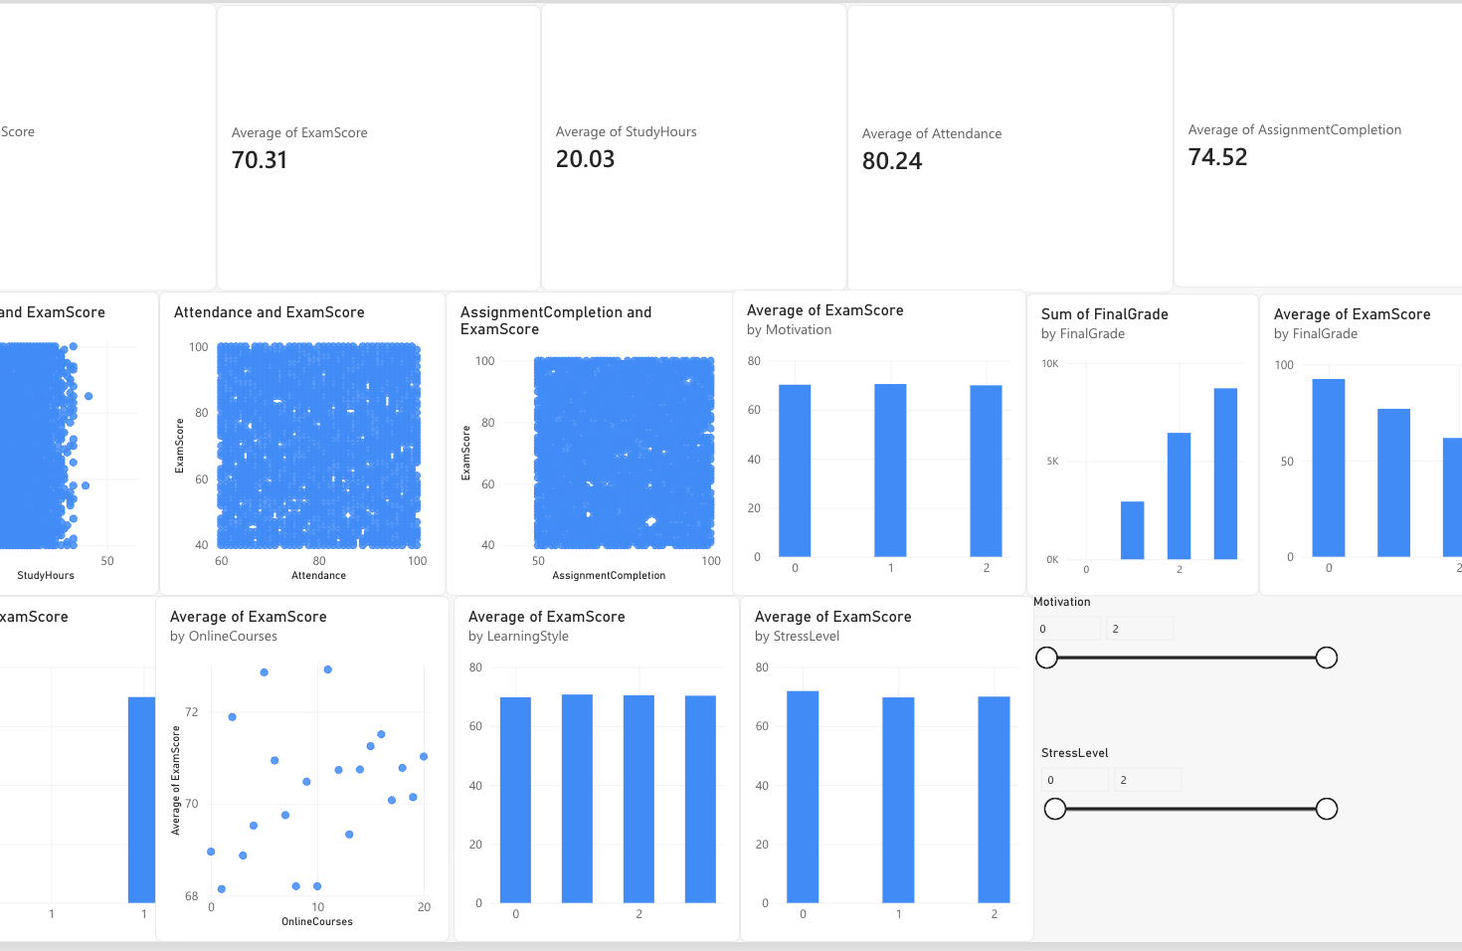
Power BI Dashboard
11

Slide 12
Key Findings
Finding 1
Finding 4
StudyHours and Attendance show very weak linear relationships with ExamScore.
The regression model has weak predictive performance (R² ≈ 0.006).
Finding 2
Finding 5
AssignmentCompletion, Discussions and StressLevel have statistically significant associations with ExamScore, but effect sizes are small.
Statistical significance should not be confused with practical importance when effects are very small.
Finding 3
Finding 6
Stress groups differ significantly in mean ExamScore; motivation groups do not.
The analysis supports association-based interpretation, not causal conclusions.
12

Slide 13
Limitations & Conclusion
Limitations
• Dataset is observational and does not establish causality.
• Many relationships are weak.
• Several categorical variables are numerically encoded.
• FinalGrade is strongly tied to ExamScore and was excluded from regression predictors.
• Results depend on the quality and scope of the Kaggle dataset.
Conclusion
The project provides a complete data-analysis pipeline from raw data to dashboard. The cleaned dataset contains 12,469 records. Most examined behavioral factors have weak linear relationships with ExamScore. Stress shows a statistically significant group difference, but the effect is very small. The regression model has low explanatory power, so the dataset alone does not provide a strong prediction of ExamScore.
13

Slide 14
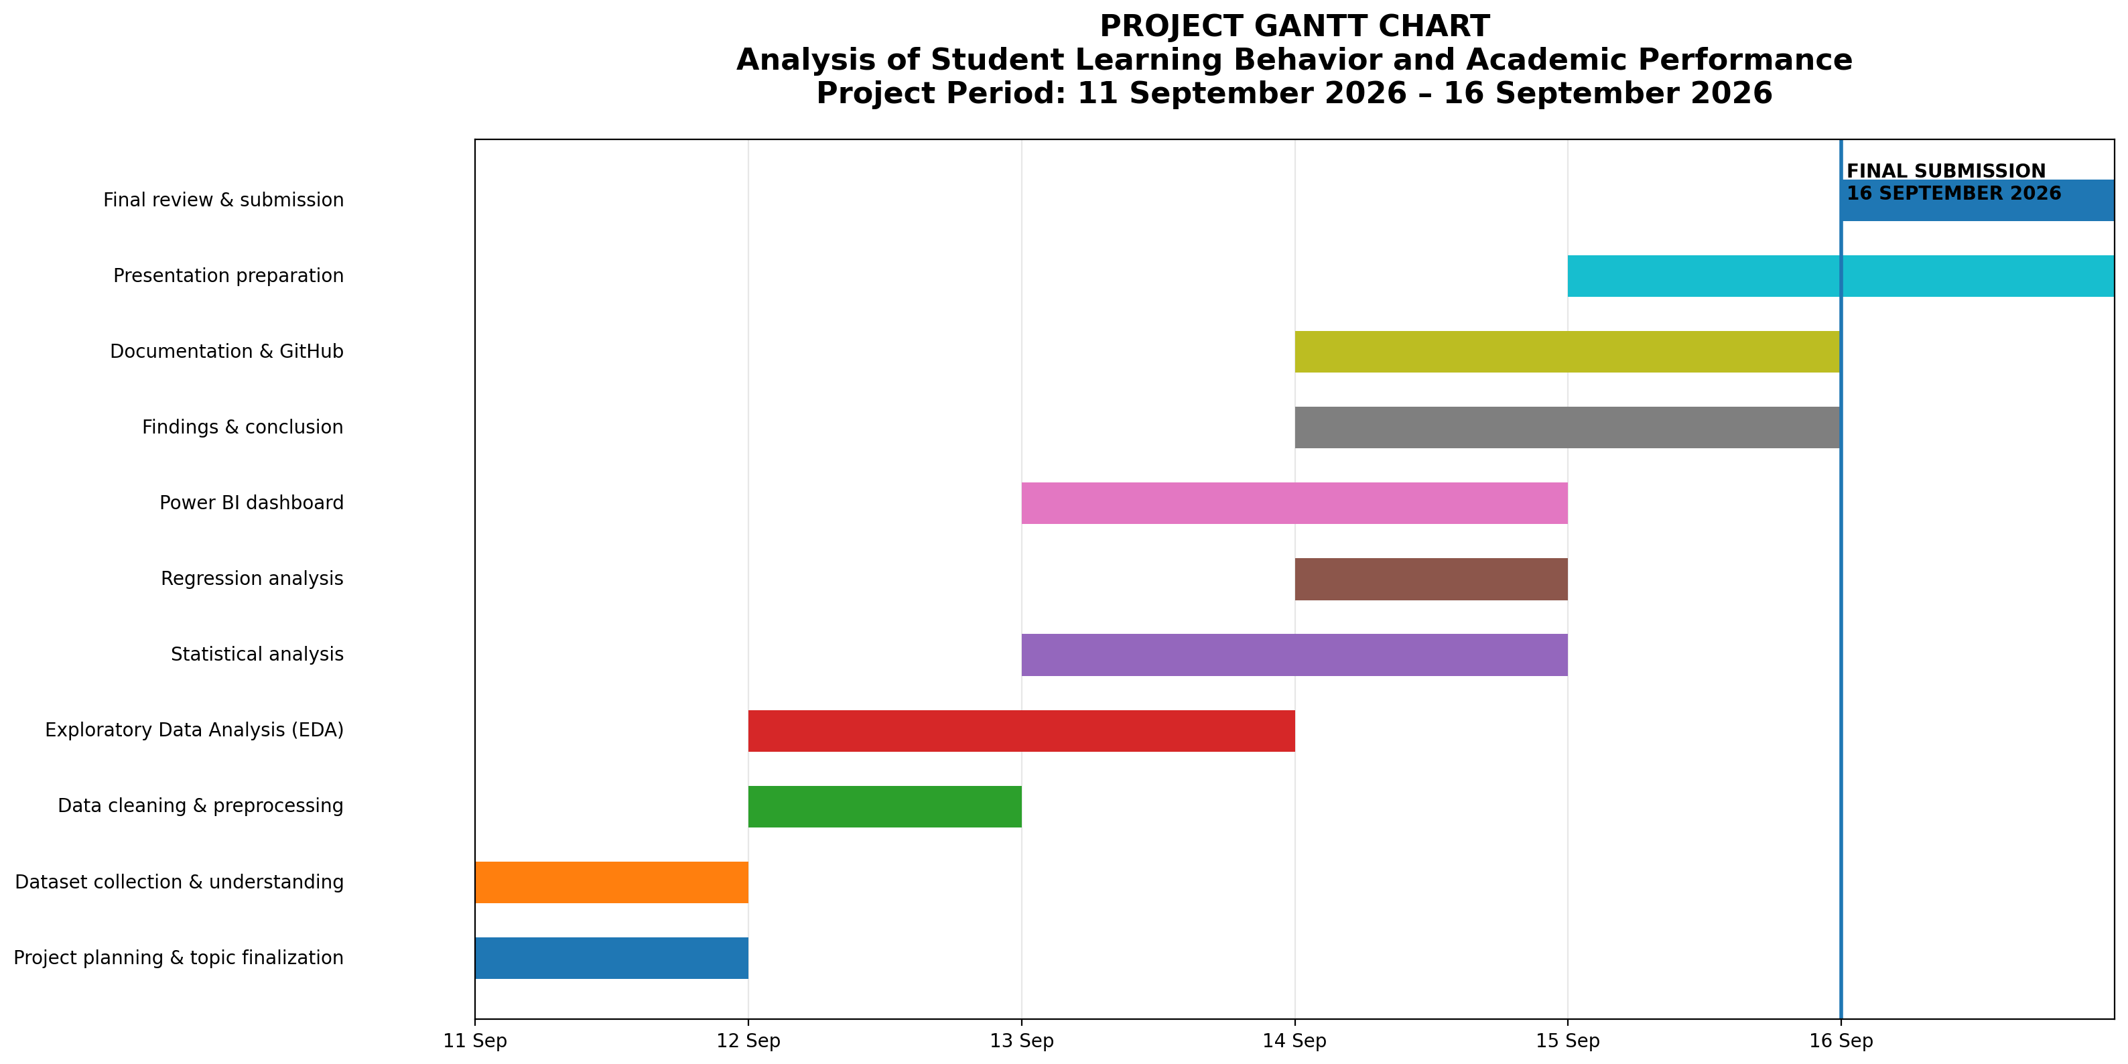
Project Plan & Deliverables
Project period: 11 September 2026 – 16 September 2026
14

Slide 15
Project Deliverables
• Cleaned dataset (12,469 records)
• Kaggle analysis notebook
• EDA, correlation, statistical and regression analysis
• Interactive Power BI dashboard
• Project proposal, mindmap and Gantt chart
• Final project report and GitHub repository
15

Slide 16
Thank you​
15

